Slide 1

DSP - Waternet
Progress report – 23rd December 2020
F4: Manuel Drijfholt, Sebastian Hemmer, Lucas Johnston , Ben Platten, Nour Salloum,

Slide 2
Progress so far
Extensive literature review
Data research and collection
Segmentation
Pipeline development
Modelling research and planning

Slide 3
Data
Output with region
Time series
Airbnb
Hotels
Population
Income

Slide 4
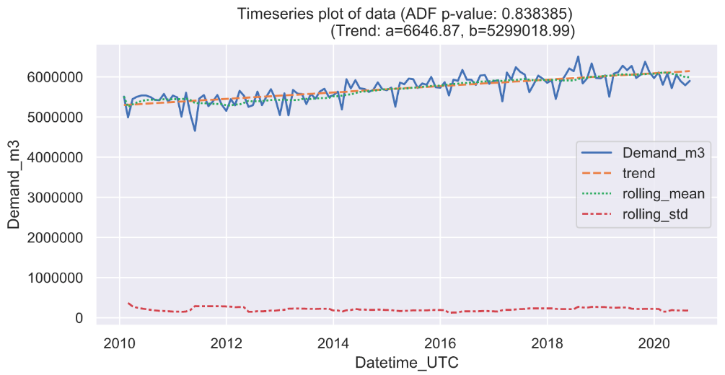
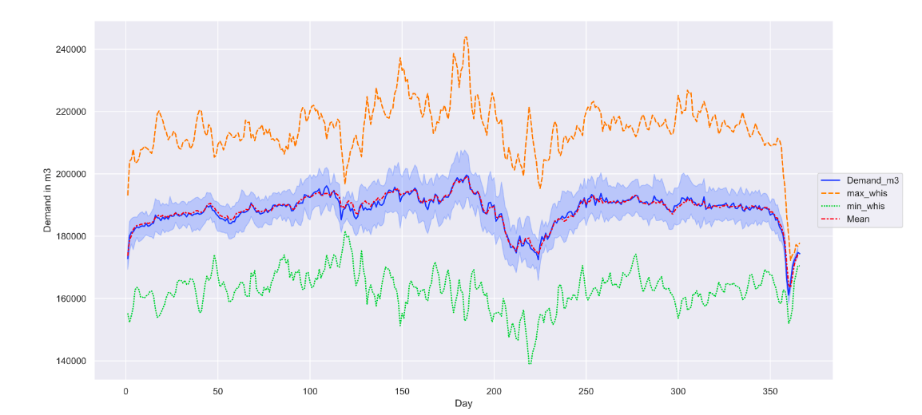
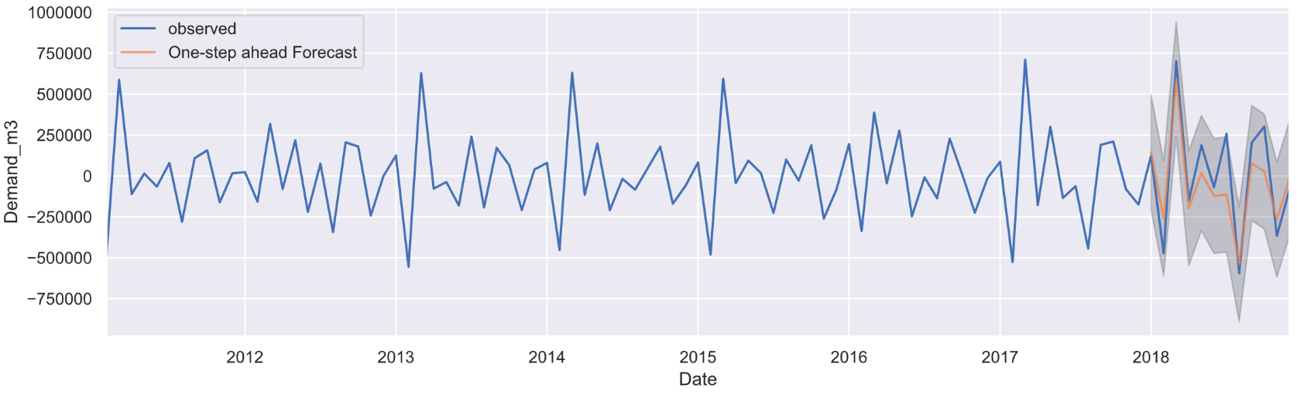
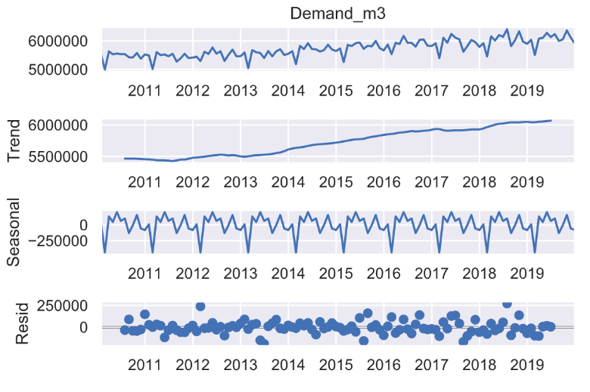
Timeseries modelling

Slide 5
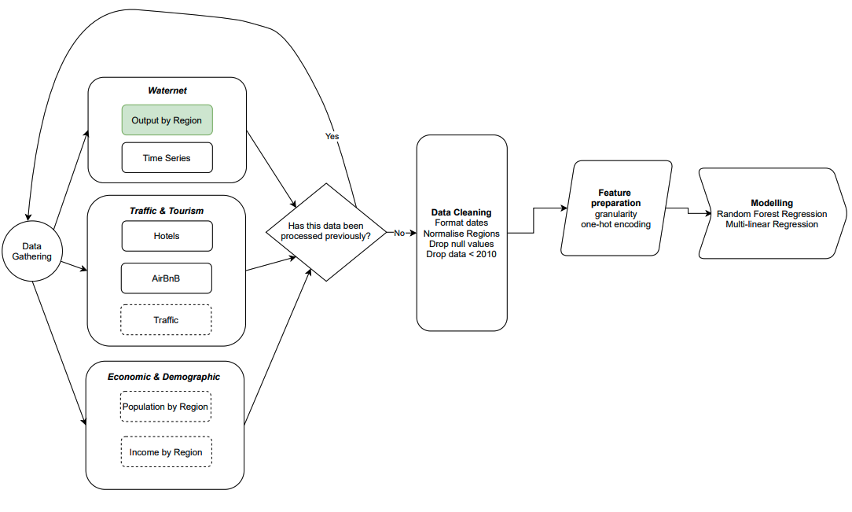
Pipeline architecture

Slide 6
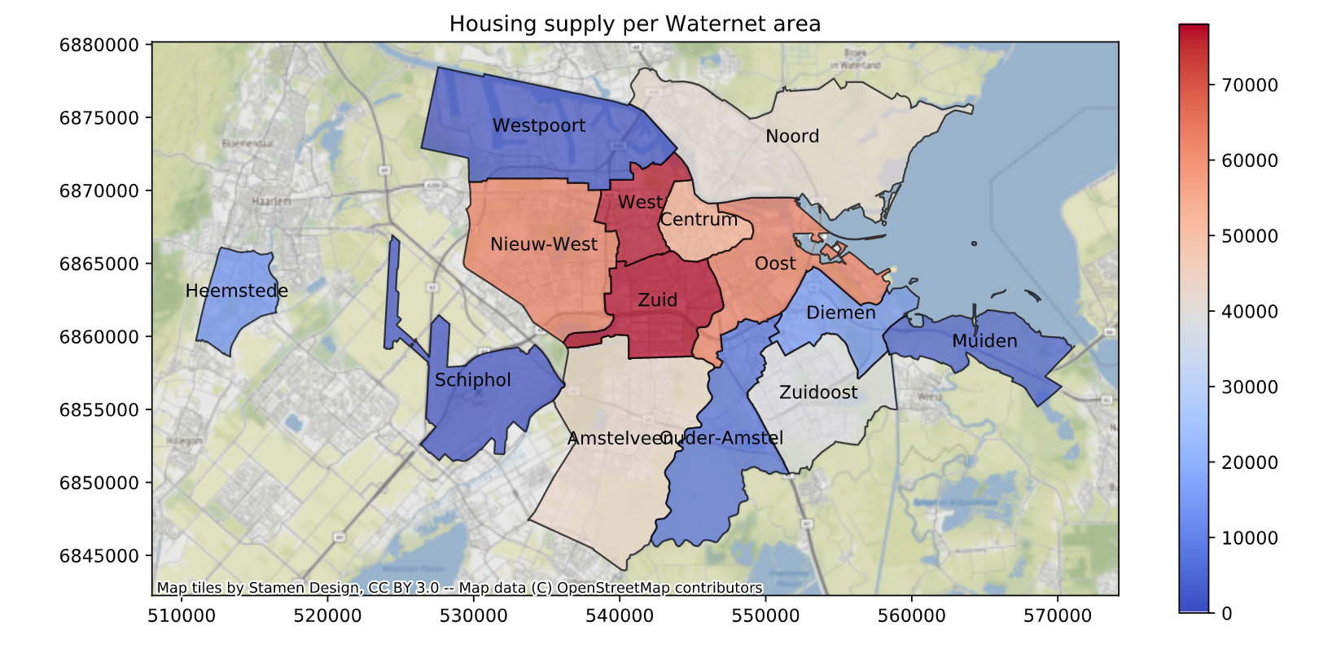
Prototype visualization

Slide 7
Next steps
Find an appropriate baseline model
Test and compare other models
Incorporate third-party data
Iterate and improve

